Slide 1
Web Fundamentals
Unveiling the Building Blocks of the Internet

Slide 2
AGENDA
Web Fundamental
Computer Networks
Evolution of Internet
TCP/IP
Internet Application
Web Protocols
Web Browser, Security
DNS – Domain Name System

Slide 3
Computer Networks
Computer networks are systems of interconnected devices such as computers, servers, routers, and switches. These networks enable these devices to communicate and share resources, like files and printers, with each other.

Slide 4
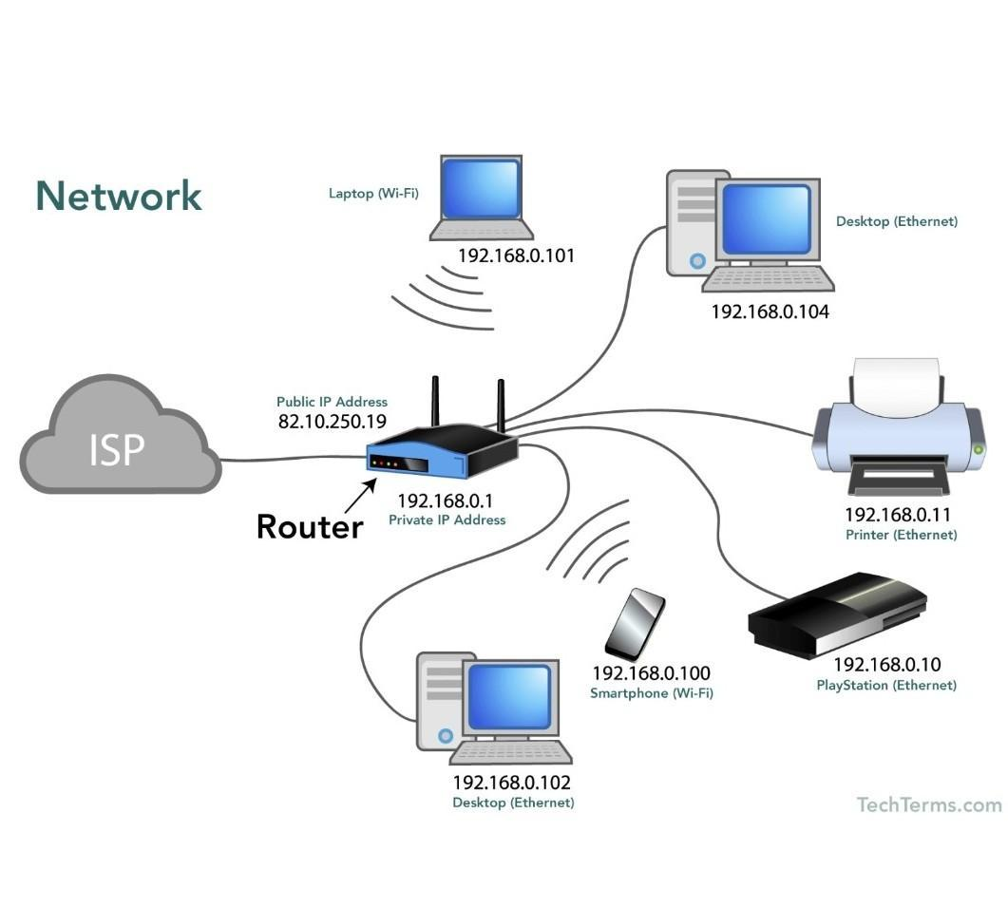

Slide 5
Introduction to the Internet:
The internet is a vast, global network of computer networks. It allows for the transmission of data, including text, images, videos, and more, between devices and users worldwide. The internet facilitates services like email, web browsing, and online gaming.

Slide 6
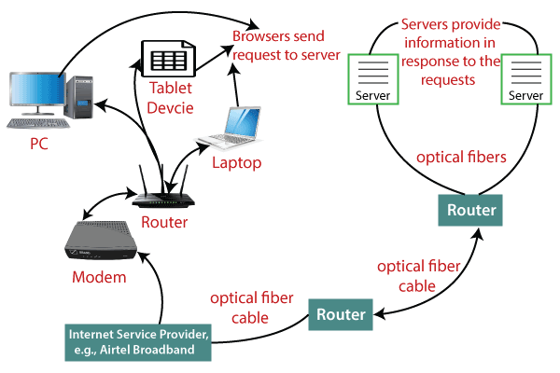

Slide 7
Evolution of the Internet
ARPANET (1969): ARPANET was the precursor to the modern internet and was created by the U.S. Department of Defense. It connected four research universities and laid the foundation for networked communication.
WWW Invention (1989): Sir Tim Berners-Lee's invention of the World Wide Web revolutionized the internet by introducing hypertext, URLs, and the first web browser.
Commercialization (late 1990s): The internet expanded from a research tool into a global commercial platform, leading to the dot-com boom.

Slide 8
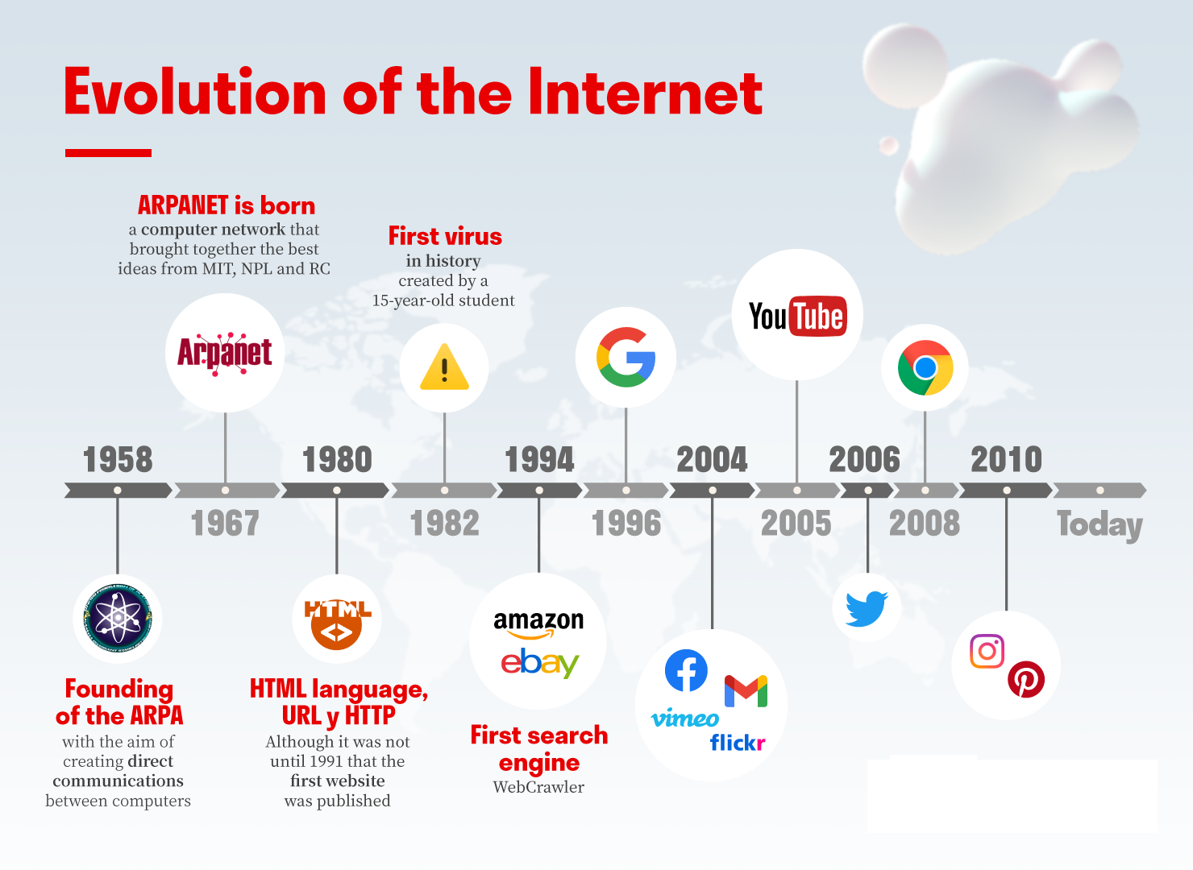

Slide 9
TCP/IP: Addressing and Routing
Explanation of TCP/IP Protocol: TCP/IP (Transmission Control Protocol/Internet Protocol) is a suite of communication protocols that enables the transmission of data between devices on the internet. It ensures that data packets are delivered reliably and in the correct order.

Slide 10
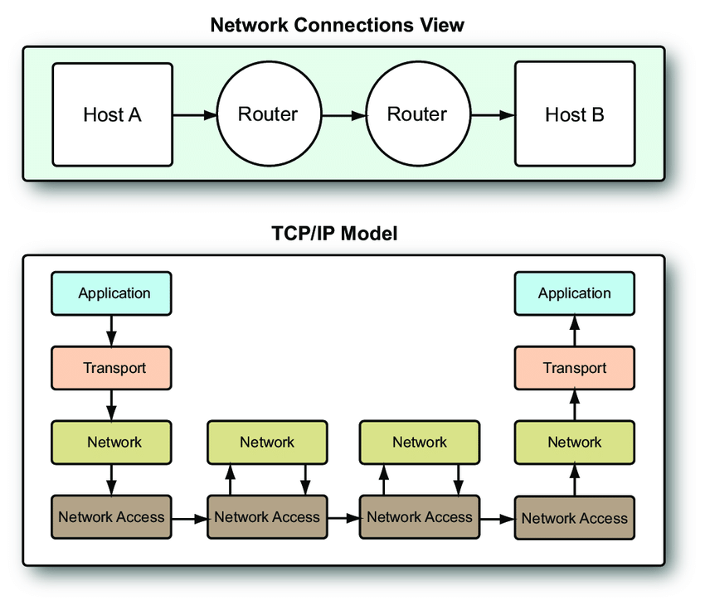

Slide 11
TCP/IP: Addressing and Routing
IPv4 vs. IPv6: IPv4 (Internet Protocol version 4) and IPv6 (Internet Protocol version 6) are addressing schemes used to identify devices on the internet. IPv6 was developed to address the exhaustion of IPv4 addresses.

Slide 12
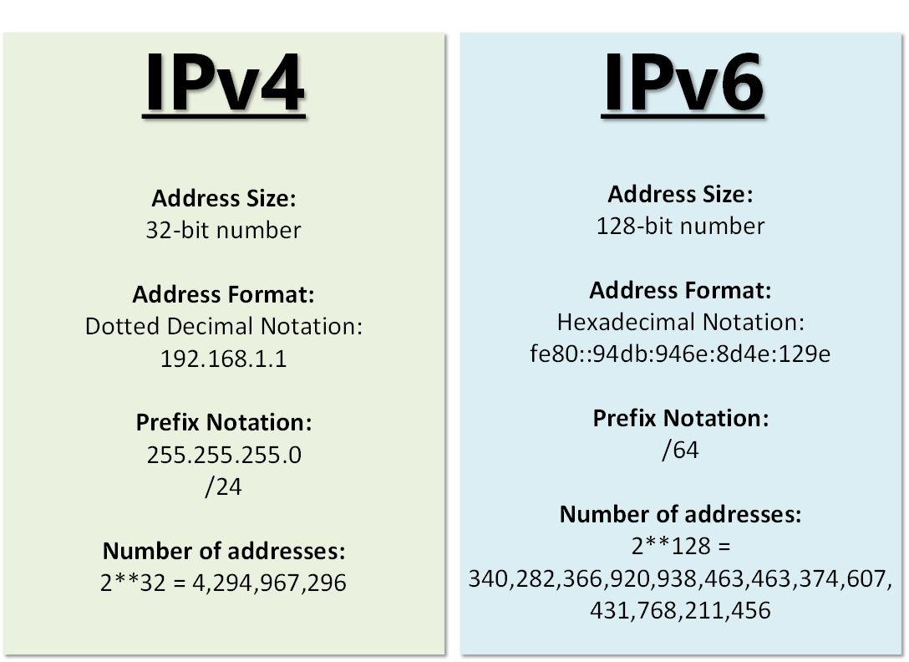

Slide 13
TCP/IP: Addressing and Routing
IP Addressing and Routing Example: Provide an example where a user in one country accesses a website hosted in another country. Explain how IP addressing and routing play a crucial role in delivering the website's content.

Slide 14
Internet Applications
FTP (File Transfer Protocol): FTP is used to transfer files between computers on a network or the internet.
Telnet: Telnet is a protocol for remote terminal access to other computers.
Email: Email enables electronic communication through messages and attachments.
Chat: Chat applications like Slack or WhatsApp allow real-time text or voice communication.

Slide 15
World Wide Web: HTTP Protocol

Slide 16
Introduction to HTTP Protocol:
HTTP (Hypertext Transfer Protocol) is the foundation of data communication on the World Wide Web. It defines how web browsers and servers communicate.

Slide 17
How Web Pages are Transmitted:
Explain that when a user requests a web page, the browser sends an HTTP request to the server, which responds with the page's content. Emphasize the role of HTML, CSS, and JavaScript in web page rendering.

Slide 18
Request and Response Example
Display a simplified HTTP request and response example. The request may include headers like "GET /page HTTP/1.1," and the response will include headers and the page's HTML content.

Slide 19
URL - Domain Name System:
→ # DNS Resolution
URL: https://www.example.com
1. Browser extracts "www.example.com."
2. Browser queries DNS server.
3. DNS server resolves the domain to an IP address (e.g., 192.0.2.1).
4. Browser connects to the IP address to fetch the web page.

